Slide 1

Car Insurance Prediction Domain-BFSI
- Aditya Mane

Slide 2

Data Overview
Data Size
2578048
Data Shape
58592 rows
44 columns
Data Types-
Object (Categorical)
Integer, Float(Numerical)

Slide 3
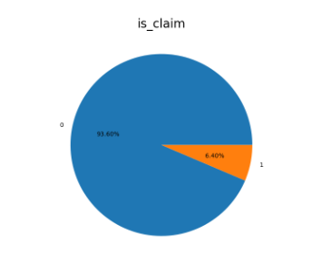
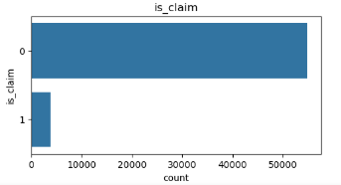
Target Variable
The target variable is (is_claim)
The percentage of number of unique values in Target column
93.60% for not claim the insurance
6.40% for claim the insurance
Class imbalance is observed

Slide 4
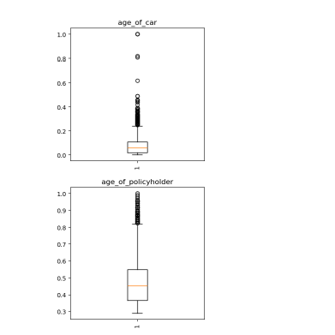
Data Preprocessing
1. Sorting Categorical and Numerical Columns in list
Sorting of numerical and categorical columns was done based on number of unique values
2. Duplicate & Missing Values
Dataset has zero duplicate values
Dataset has zero missing values
3. Outlier Treatment
‘age_of_car’ and ‘age_of_policyholder’ have outliers
Used IQR Method was used to remove outliers age_of_car and age_of_policyholder
Outliers were replaced by upper limit and lower limit

Slide 5
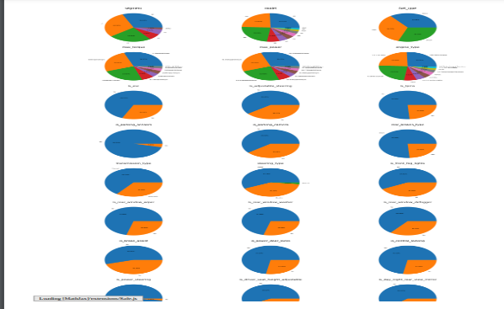
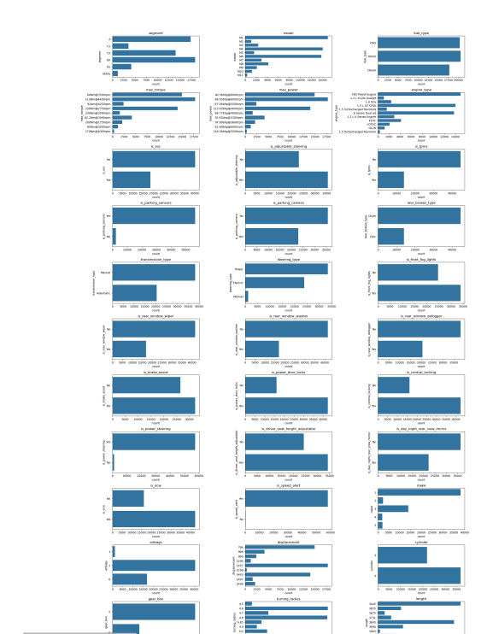
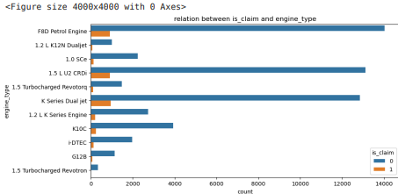
EDA- Categorical
.
.
Pie chart
Ensured segments were appropriately labeled and visually distinct for clarity.
Included percentage values to enhance understanding of relative contributions.
Count plot
Utilized count plots to visualize the frequency distribution of categorical variables.
Count plot with hue of target column
created count plot with the hue parameter to visualize the distribution of categories across different target groups
.

Slide 6
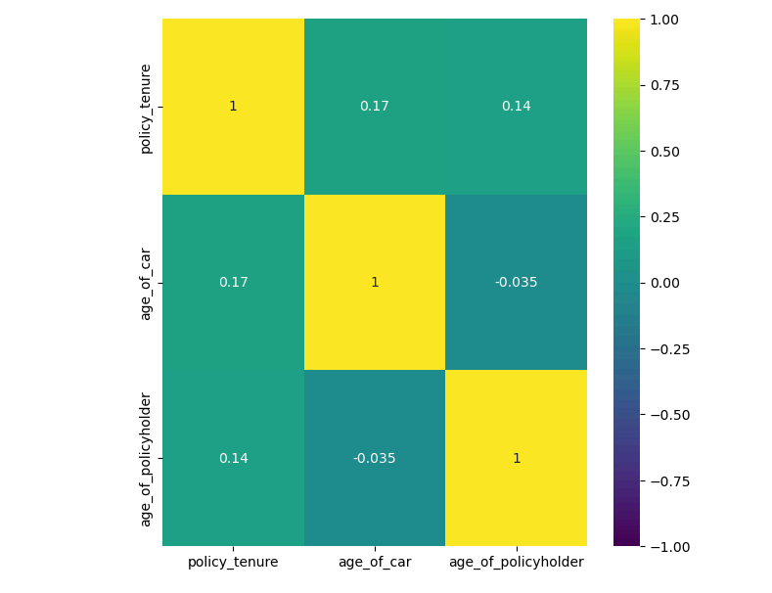
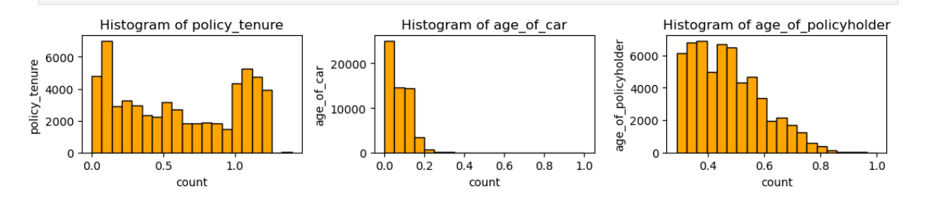
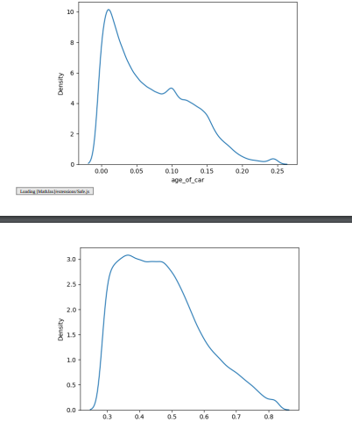
EDA - Numerical
Heatmap
We can see that very less multi-collinearity in numerical columns
Histogram
histograms to visualize the frequency distribution of numerical variables.
Data is also right skewed
KDE plot
Data is right skewed

Slide 7
Label Encoding and Standardization
Label Encoding: Label Encoding was done on Categorical columns
Standard-Scaling: Standard Scaling was done on Numerical columns after train test split to avoid data leakage
Class Imbalance is also handled using over sampling

Slide 8
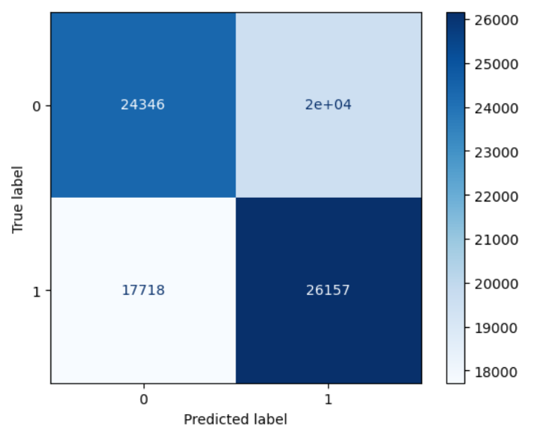
Model Building
Logistic Regression
logistic regression to predict binary or categorical outcomes based on input features.
Evaluated model accuracy using metrics like confusion matrix, train-test accuracy score, precision score, and recall score
Accuracy : train=0.57, test=0.58
Precision : train=0.57, test=0.57
Recall : train=0.59, test=0.60

Slide 9
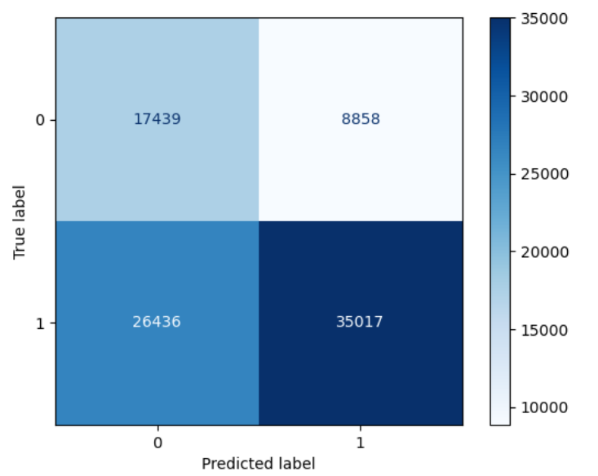
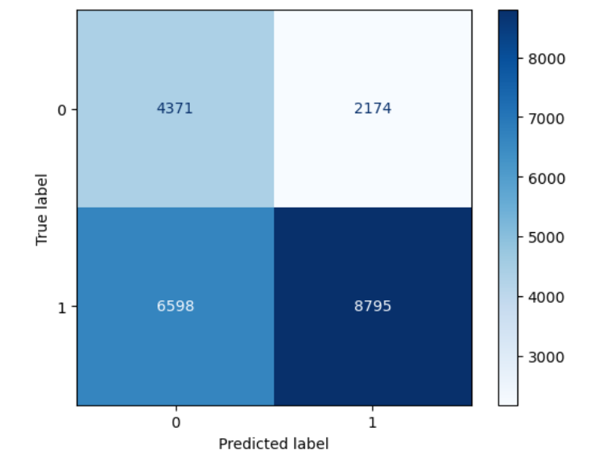
Model Building
Decision Tree
Built decision tree models to split data into decision-based segments for classification or regression tasks
Applied pruning techniques and set depth limits to reduce overfitting.
Enhanced model transparency by providing clear rules for predictions
Accuracy : train=0.59, test=0.60
Precision : train=0.79, test=0.80
Recall : train=0.56, test=0.57
F1 Score : train=0.66, test=0.66

Slide 10
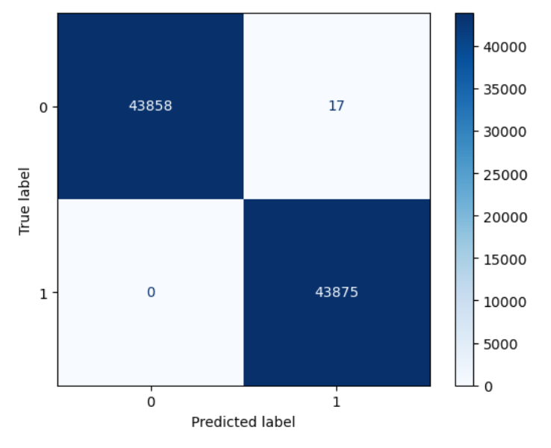
Model Building
Random Forest
At each node, a random subset of features is considered for splitting, which helps in reducing overfitting and enhances model generalization.
It can be used for both classification and regression tasks
Accuracy : train=0.99, test=0.98
Precision : train=0.99, test=0.96
Recall : train=1.0, test=1.0

Slide 11
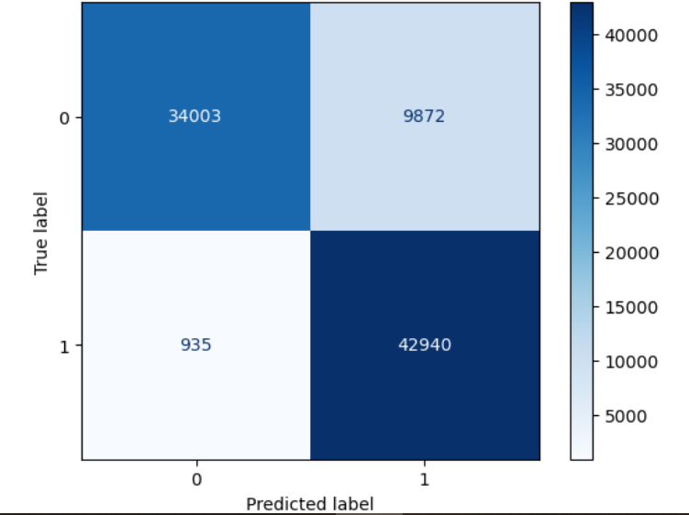
Model Building
Grid Search CV with Random Forest
Using Grid Search CV for selecting best Hyper-Parameter in Random Forest
Accuracy : train=0.87, test=0.85
Precision : train=0.81, test=0.79
Recall : train=0.98, test=0.98

Slide 12
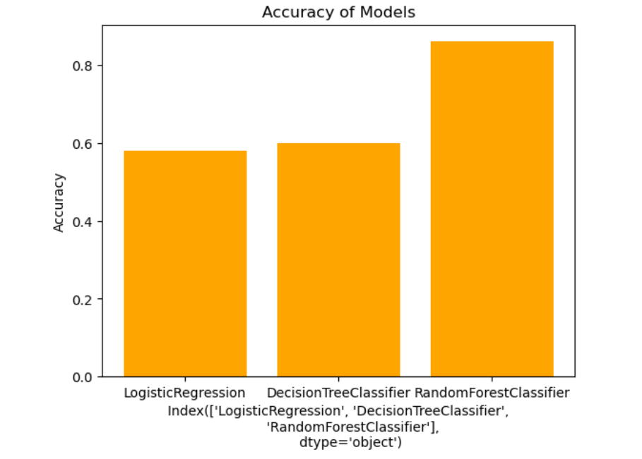
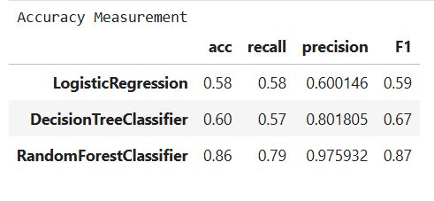
Selecting Best Model
Random Forest is Best Model as it is able to Balance Precision & Recall

Slide 13


